Slide 1
Huda Beauty -
Easy Bake Setting Spray
Audience360 Post Campaign Report

Slide 2
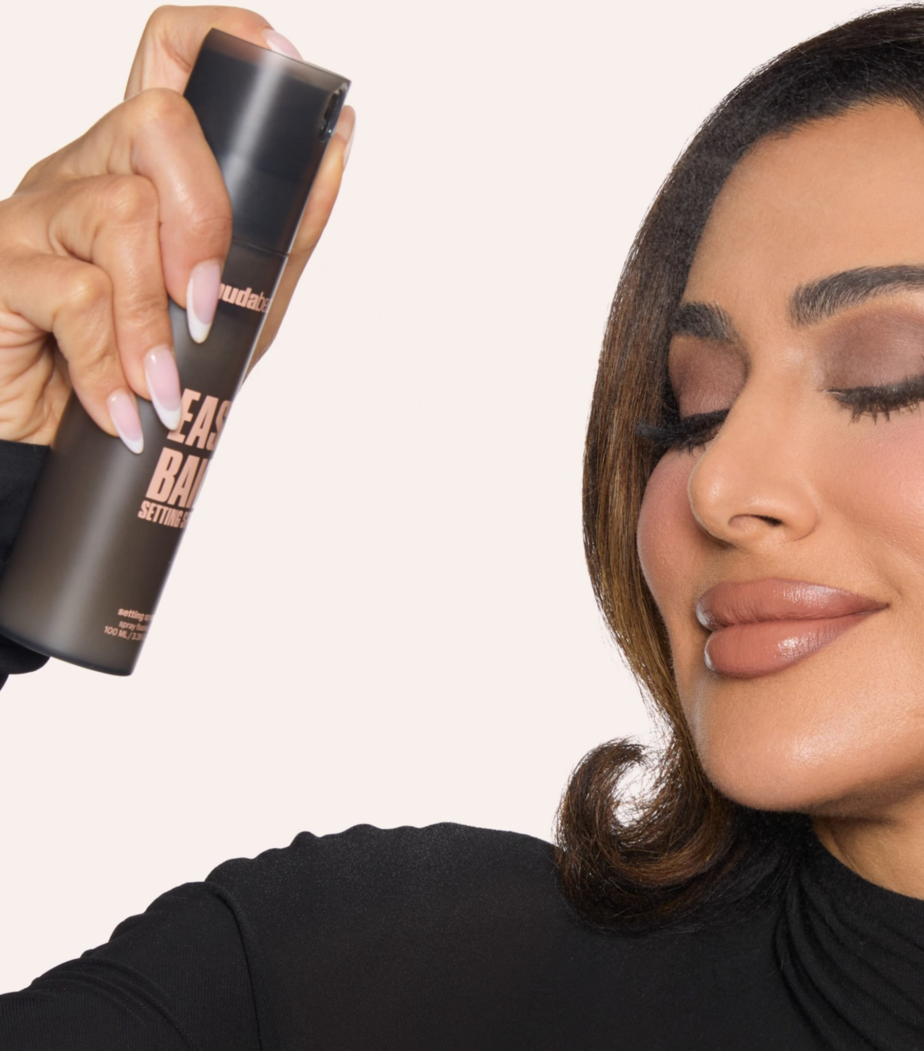
01
Campaign brief summary
02
Post campaign report
Overall campaign performance
Meta campaign performance
TikTok campaign performance
03
Learnings & Recommendations

Slide 3
01
Campaign Brief Summary
OUR APPROACH

Slide 4
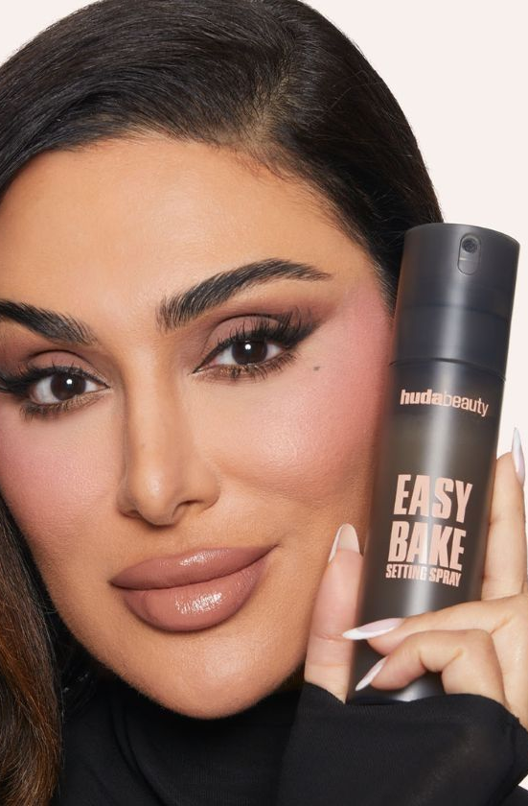
Campaign Summary
Brand:
Huda Beauty
Campaign:
Easy Bake Setting Spray
Flight Dates:
15/05/25-10/07/25
(8 weeks)
Channels:
Meta (IG/FB)
TikTok
Objective:
Drive awareness of the new product, Huda Easy Bake Setting Spray, and drive sales for the NPD and wider range.
Primary KPIs
Unique Reach and CPM
Secondary KPIs
Return On Ad Spend (ROAS)
Further measurement:
New-to-brand measurement

Slide 5
02
Post Campaign Report
The following analysis is based on exposed audience.

Slide 6
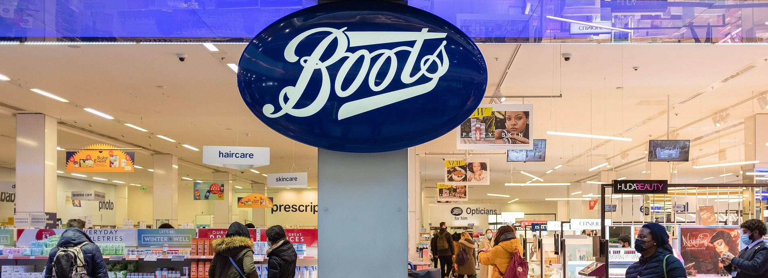







Total Campaign Summary
Delivery Performance
GROSS
SPEND
IMPRESSIONS
UNIQUE REACH
FREQUENCY
CLICKS
CTR
Net CPM
£79,763
6 total
1 p/w
12,294,399
2,033,586
29,325
0.24%
£4.55
Estimated:
£80,000
Estimated:
9,364,548
Estimated:
497,174
Estimated:
3 per week
18 total
Estimated:
8,949
Estimated:
0.10%
Estimated:
£6.41

Slide 7
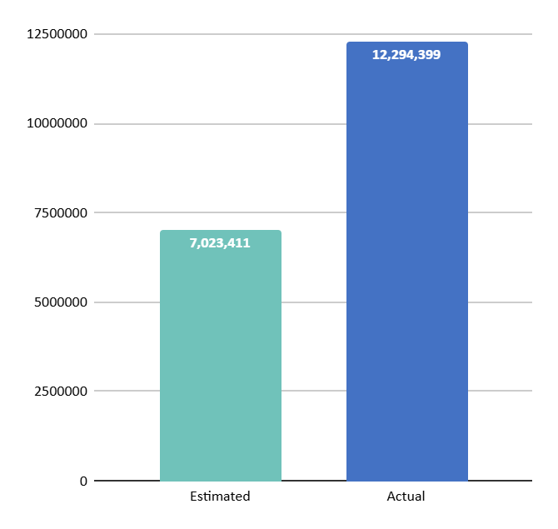
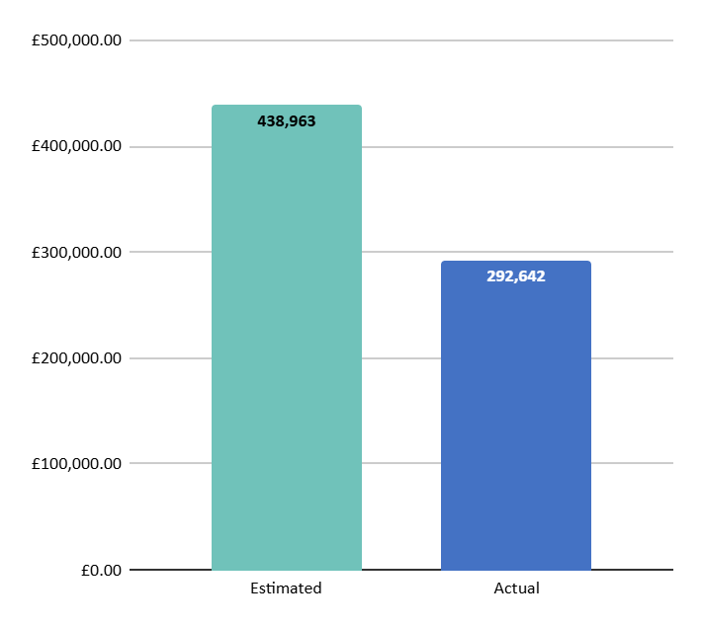
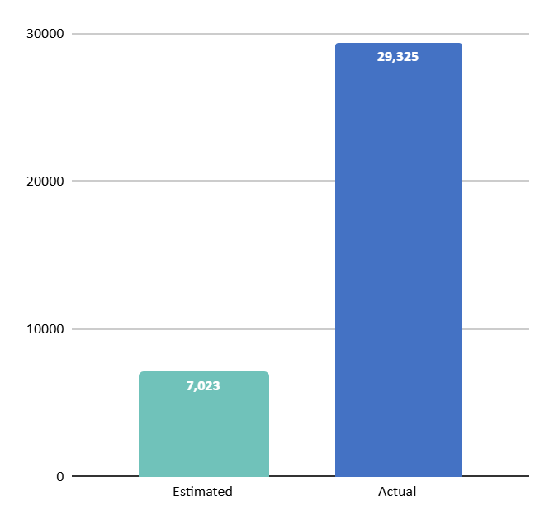
Our campaign over delivered on planned traffic & engagement metrics, suggesting ads drove interest and consideration amongst prospective Boots shoppers
+55%
128%
+123%
IMPRESSIONS
REACH
CLICKS

Slide 8
TikTok delivered a more cost-efficient CPM and enabled the campaign to deliver more impressions than expected
Reach
Impressions
CTR
Net CPM
Link Clicks
Gross Spend
Brand Revenue
Product Revenue*
Overall
2,033,586
12,294,399
0.24%
£4.55
29,325
£79,763
£16,680.56
£0.40 ROAS
£15,657.15
£0.37 ROAS
Reach
Impressions
CTR
Net CPM
Link Clicks
Gross Spend
Brand Revenue
Product Revenue*
Meta
830,834
6,833,434
0.21%
£6.12
14,687
£59,763
£16,680.56
£0.40 ROAS
£0.28 ROI
£15,657.15
£0.37 ROAS
£0.26 ROI
Reach
Impressions
CTR
Net CPM
Link Clicks
Gross Spend
Brand Revenue
Product Revenue
TikTok
1,202,752
5,460,965
0.27%
£2.56
14,638
£20,000
N/A
N/A
*Product measurement is only available on Meta.

Slide 9

Whilst the campaign delivered strong traffic performance, it struggled to deliver a positive Brand & FSKU ROAS
Brand Units
693
Brand Revenue
£16,680.56
Brand ROAS
£0.40
FKSU
Units
545
FKSU Revenue
£15,657.15
FKSU
ROAS
£0.37
FSKUs for measurement: Setting Spray – 9134107, Easy Bake Loose Powder – Pound Cake - 8809372, Easy Blur Foundation – Latte - 5206022, Easy Blur Primer - 5205883
Notes:
Note this only considers Meta data since we cannot attribute TikTok sales

Slide 10
56% of brand sales were made in-store, highlighting the role of the in-store shopping experience
Online Unit Sales
306
Online Revenue
£7,117.86
Online AOV
£23.26
In Store Unit Sales
387
In Store Revenue
£9,562.70
In Store AOV
£24.70

Slide 11
Post-campaign Report: Meta
The following analysis is based on exposed audience.

Slide 12
Total Campaign Summary
Delivery Performance
GROSS
SPEND
IMPRESSIONS
UNIQUE REACH
FREQUENCY
CLICKS
CTR
Net CPM
£59,763
8 total
1 p/w
14,687
£6.12
6,833,434
830,834
0.21%
Estimated:
£60,000
Estimated:
7,023,411
Estimated:
390,189
Estimated:
16 total
2 p/w
Estimated:
7,023
Estimated:
0.10%
Estimated:
£5.98

Slide 13
Broader and competitor audiences drove scale & reach, whilst existing brand buyers drove strong ROAS.
Strongest sales performance from brand-loyal customers
Current & Lapsed Huda Beauty shoppers delivered the strongest ROAS overall, showing that loyal audiences played a key role in driving NPD sales and franchise uplift, directly supporting the campaign’s secondary objective.
Broad category and competitor audiences helped drive awareness
Segments such as Foundation Shoppers, Propensity Model, and Competitor Setting Spray shoppers delivered significant reach and impressions but returned minimal revenue and a low ROAS. This suggests they were valuable for awareness of the new product but less efficient for conversion. Future campaigns with sales objectives should consider further refining these audiences to meet relevant Boots shoppers.

Slide 14
Audience Performance breakdown
Audience Segment | Net Media Spend | Impressions | Reach | Frequency | Clicks | CTR | Net CPM | Brand Revenue | Brand ROAS
Current Huda Beauty Shoppers L12M | £8,521.80 | 964,830 | 42,111 | 23 | 2,935 | 0.30% | £8.83 | £10,619.28 | £0.87
Foundation Shoppers L24M | £3,182.90 | 674,711 | 257,551 | 3 | 1,185 | 0.18% | £4.72 | £177.66 | £0.04
Lapsed Huda Beauty Shoppers L12M-L24M | £4,739.00 | 533,291 | 21,047 | 25 | 1,369 | 0.26% | £8.89 | £1,870.01 | £0.28
Huda Beauty (Setting Spray) Competitor List L3M-L24M | £3,300.50 | 822,985 | 158,381 | 5 | 1,628 | 0.20% | £4.01 | £1,009.40 | £0.31
NPD Beauty Shoppers | £2,965.90 | 911,395 | 316,164 | 3 | 1,463 | 0.16% | £3.25 | £586.66 | £0.14
Premium Cosmetics Propensity Model | £3,422.30 | 854,495 | 210,362 | 4 | 1,436 | 0.17% | £4.01 | £160.81 | £0.03
Setting Spray Shoppers L6M | £13,156.50 | 1,663,017 | 66,738 | 25 | 3,682 | 0.22% | £7.91 | £1,986.99 | £0.11
Video retargeting | £2,545.20 | 408,710 | 21,771 | 19 | 989 | 0.24% | £6.23 | £269.75 | £0.07
Total | £41,831.68 | 6,833,434 | 830,834 | 8 | 14,687 | 0.21% | £6.12 | £16,680.56 | £0.40

Slide 15

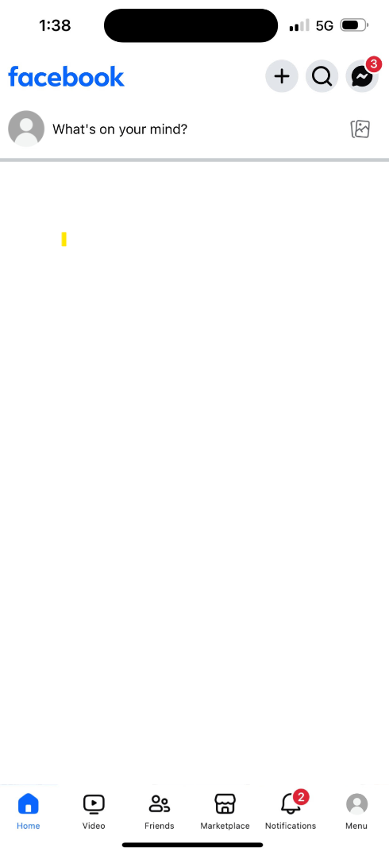
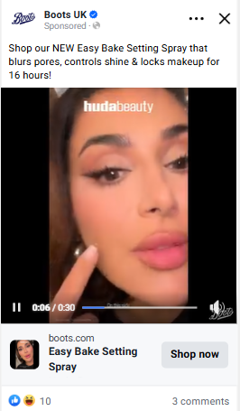
1.1 HUDA 2 EBSS PAID SOCIAL ad drove the strongest ROAS & volume of impressions
IMPRESSIONS:
3,143,859
REACH:
606,895
SPEND:
£18,860.14
FREQ:
5
ROAS:
£0.48
CPM:
£6.00
LINK CLICKS:
7,582
CTR:
0.24%
This creative effectively showcased the product, showcasing a before and after as well as highlighting it being with brand ambassador, the product key uses and discount offer in the ad copy.
To further strengthen the messaging, consider incorporating statistics and key USPs that further demonstrate product efficacy, along with promotion call-outs where relevant.
​

Slide 16
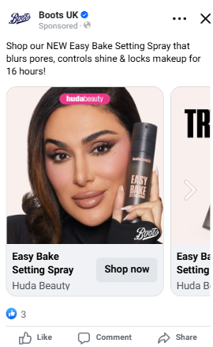
Carousel 1 struggled to drive both traffic and ROAS, highlighting an opportunity to refine messaging or format in future campaigns
IMPRESSIONS:
469,183
REACH:
246,649
SPEND:
£2,882.96
FREQ:
2
CPM:
£6.14
LINK CLICKS:
1,081
CTR:
0.23%
ROAS:
£0.25
This brand-led creative was effective in driving awareness and reach, however did not drive users to click through or convert to Huda Beauty.
Test other ad formats and creative styles to drive excitement about the new launch of the new product.

Slide 17
Total Creative Performance
Ad | Impressions | Reach | Frequency | Net Media Spend | CPM | Clicks | CTR | Brand Revenue | Brand ROAS
1.1 HUDA 1 EBSS PAID SOCIAL | 1,730,803 | 514,886 | 3 | £10,160.68 | £5.87 | 2,640 | 0.15% | £3,594.97 | £0.35
1.1 HUDA 2 EBSS PAID SOCIAL | 3,143,859 | 606,895 | 5 | £18,860.14 | £6.00 | 7,582 | 0.24% | £9,116.42 | £0.48
Carousel 1 | 469,183 | 246,649 | 2 | £2,882.96 | £6.14 | 1,081 | 0.23% | £709.62 | £0.25
Carousel 2 | 370,712 | 218,573 | 2 | £2,350.99 | £6.34 | 785 | 0.21% | £810.93 | £0.34
Carousel 3 | 623,554 | 302,730 | 2 | £4,405.12 | £7.06 | 1,478 | 0.24% | £1,371.46 | £0.31
Carousel 4 | 495,323 | 244,395 | 2 | £3,171.79 | £6.40 | 1,121 | 0.23% | £1,077.16 | £0.34
Total | 6,833,434 | 830,837 | 8 | £41,831.68 | £6.12 | 14,687 | 0.21% | £16,680.56 | £0.40

Slide 18
Post-campaign Report:
TikTok
The following analysis is based on exposed audience.

Slide 19
Campaign Summary
Delivery Performance
GROSS
SPEND
IMPRESSIONS
REACH
FREQUENCY
CLICKS
CTR
CPM
5 total
1 p/w
£20,000
5,460,965
1,202,752
14,638
0.27%
£2.56
Estimated:
£20,000
Estimated:
2,341,137
Estimated: 160,477
Estimated:
10 total
2 p/w
Estimated:
2,341
Estimated:
0.10%
Estimated:
£5.11

Slide 20
Lapsed Huda Beauty Shoppers L12-24M
delivered the largest volume of link clicks & impressions overall, indicating strong purchase intent
 | Impressions | Reach | CPM | Net Media Spend | Frequency | Link Clicks | CTR | 6-second video views | VTR
Total | 5,460,965 | 1,202,752 | £2.56 | £14,000 | 5 | 14,638 | 0.27% | 396,622 | 0.99%
Current Huda Beauty Shoppers L12M | 867,734 | 341,587 | £2.24 | £1,943.73 | 3 | 2,355 | 0.27% | 58,752 | 1.00%
Huda Beauty Setting Spray Competitor Shoppers L3M-L24M | 57,798 | 39,447 | £3.48 | £201.30 | 1 | 134 | 0.23% | 5,766 | 1.00%
Lapsed Huda Beauty Shoppers L12-24M | 2,911,998 | 877,396 | £2.47 | £7,205.54 | 3 | 7,988 | 0.27% | 203,113 | 0.99%
NPD Beauty Shoppers | 197,683 | 124,020 | £3.33 | £658.32 | 2 | 534 | 0.27% | 16,733 | 0.99%
Premium Cosmetics Propensity Model | 37,457 | 23,873 | £3.18 | £119.20 | 2 | 99 | 0.26% | 2,883 | 0.99%
Setting Spray Shoppers L6M | 1,388,295 | 545,372 | £2.79 | £3,870.43 | 3 | 3,528 | 0.25% | 109,375 | 0.99%

Slide 21
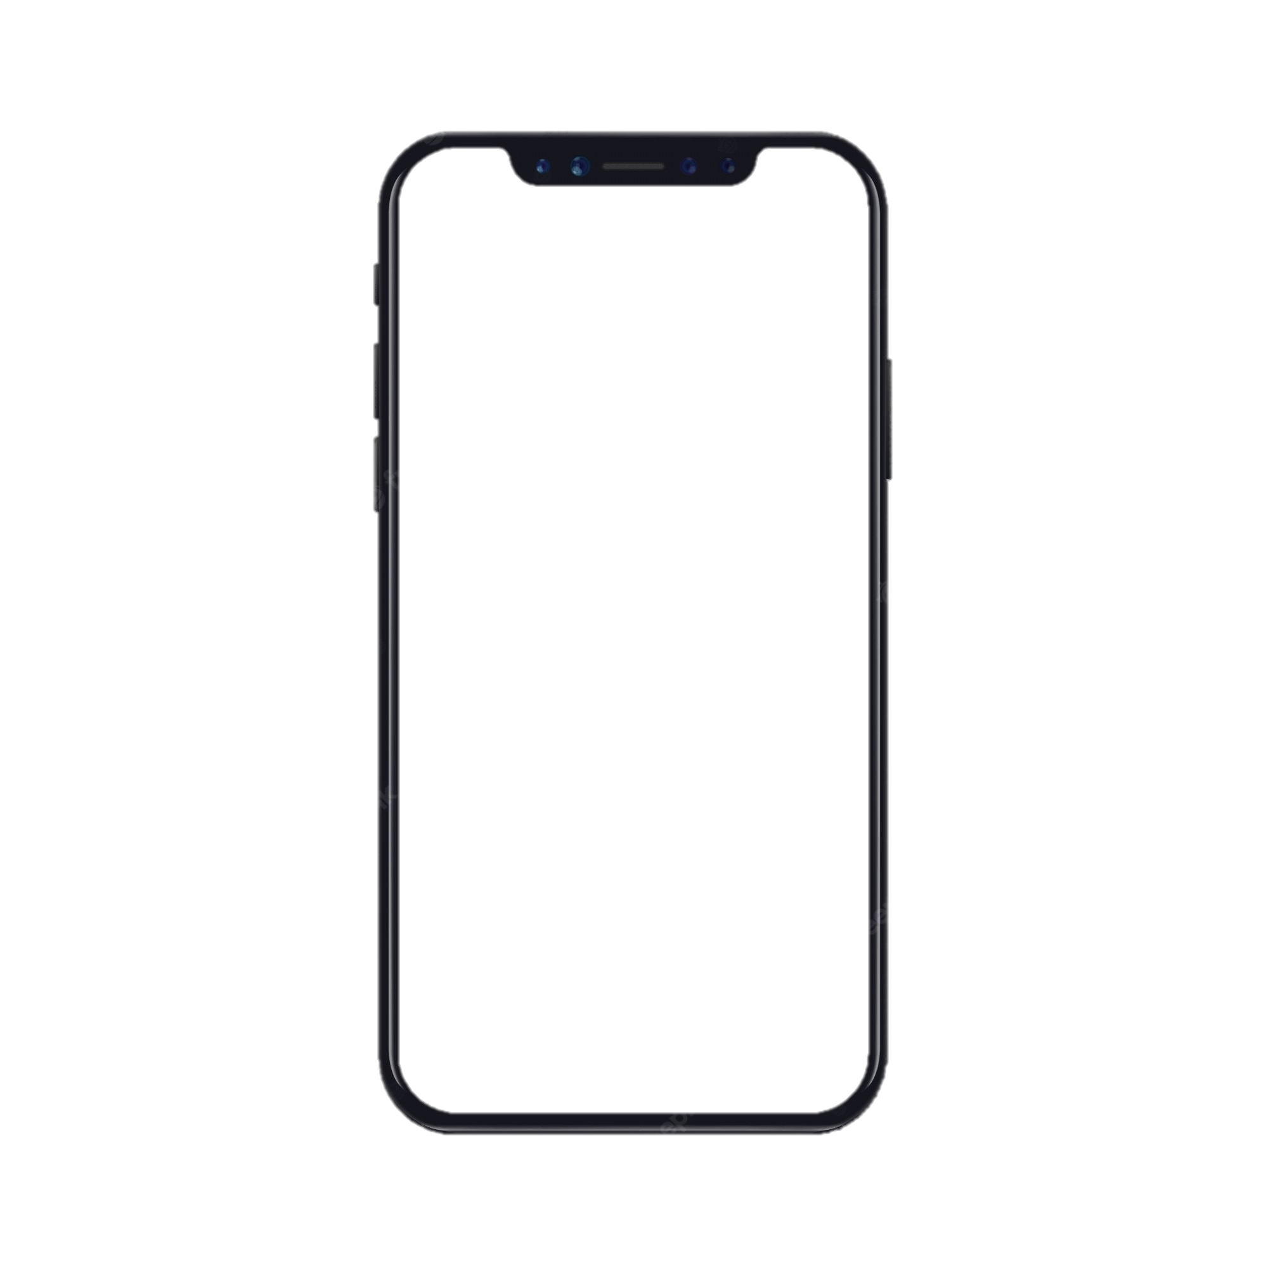
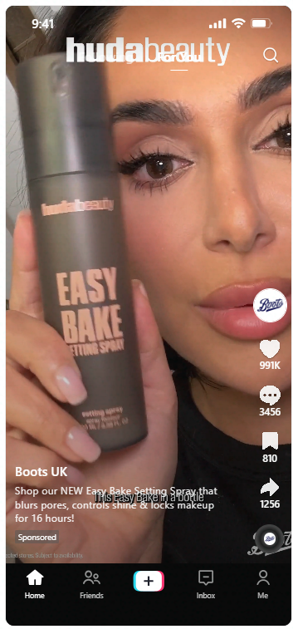
The UPDATED BOOTS 9.16 HUDA 2 EBSS PAID SOCIAL
ad drove the largest volume of impressions and reach
IMPRESSIONS:
3,657,912
REACH:
1,680,670
SPEND:
£9,875.47
FREQ:
2
CPM:
£2.70
LINK CLICKS:
9,426
CTR:
0.26%
VTR:
99.46%
This ad format was effective in driving scale and reach, helping to meet campaign overall objectives.
Leverage UGC-style content across TikTok in future campaigns to maximise reach and engagement. Given this ads’ cost-efficient CPM, consider using them strategically in awareness driving campaigns. This ad had a really strong VTR, suggesting users were engaged and interested.

Slide 22
UPDATED BOOTS 9.16 HUDA 1 EBSS PAID SOCIAL strong CTR suggests broad audience appeal and therefore effective creative alignment
CTR (%)
Ad | Audience Name
 | Current Huda Beauty Shoppers L12M | Lapsed Huda Beauty Shoppers L12-24M | NTB Huda Beauty Setting Spray Competitor Shoppers L3M-L24M | NTB NPD Beauty Shoppers | NTB Premium Cosmetics Propensity Model | NTB Setting Spray Shoppers L6M
UPDATED BOOTS 9.16 HUDA 1 EBSS PAID SOCIAL | 0.27% | 0.25% | 0.30% | 0.25% | 0.29% | 0.31%
UPDATED BOOTS 9.16 HUDA 2 EBSS PAID SOCIAL | 0.25% | 0.24% | 0.28% | 0.29% | 0.27% | 0.24%

Slide 23
Total Creative Performance
Ad Name | Impressions | Reach | Frequency | Net Media Spend | CPM | Link Clicks | CTR | Views | VTR
UPDATED BOOTS 9.16 HUDA 1 EBSS PAID SOCIAL | 1,803,053 | 868,033 | 2 | £13,998.52 | £7.76 | 5,212 | 0.29% | 1,794,281 | 99.51%
UPDATED BOOTS 9.16 HUDA 2 EBSS PAID SOCIAL | 3,657,912 | 1,680,670 | 2 | £9,875.47 | £2.70 | 9,426 | 0.26% | 3,638,333 | 99.46%

Slide 24
Learnings & recommendations for future activations
03

Slide 25
A recap on our objectives…
Drive awareness of Easy Bake Setting Spray at Boots
Did we meet this objective?
Yes Delivering 12m impressions across A360 campaign, and reaching 2m unique prime prospective Boots shoppers, we have successfully spread the news of the Huda Beauty Easy Bake Setting Spray to a wide audience of interested Boots shoppers.
Drive conversion of the NPD and wider range at Boots
Did we meet this objective?
Work in progress We saw limited returns attributable to the A360 campaign, however strong engagement and consideration metrics, highlighting the campaign effectively drove brand interest and warmed leads for conversion.

Slide 26
But, what have we learnt?
And how do we apply these learnings to drive better performance in future A360 campaigns?
Notes:
What did we learn?

Slide 27
Learnings & considerations to take forward into future campaign planning
Learning: The campaign generated strong reach, impressions, and CTR, but failed to convert efficiently, with ROAS at £0.40.
Recommendation:
Adopt a phased campaign approach. Begin with an awareness phase (broad audiences, storytelling content), then shift into a conversion phase (retargeting, sales-led creatives) to improve sales performance.
Learning: TikTok drove cost-efficient reach and engagement, whilst Meta delivered measurable, though somewhat modest, sales impact.
Recommendation:
Maintain a multi-channel strategy, using TikTok for awareness and scale, and Meta for sales-objectives and conversion. Consider activating Pinterest, which has previously driven strong ROAS for beauty campaigns, with a broad audience of beauty consumers to tap into.
Learning: 56% of sales occurred in-store, confirming that retail presence is critical to Huda Beauty’s success at Boots.
Recommendation:
Pair digital campaigns with in-store activations to close the loop and maximise conversion.

Slide 28
Learnings & considerations to take forward into future campaign planning
Learning: Current and Lapsed Huda shoppers produced the strongest ROAS, whilst broad category & competitor audiences delivered awareness but limited attributed sales.
Recommendation:
Prioritise loyal and lapsed audiences for campaigns with sales-driven objectives. Use competitor/broader audiences for awareness tactics, with refined targeting (e.g. Boots app users) to improve efficiency.
Learning: Creative featuring ambassador-led before/after storytelling drove strong ROAS, whilst carousels underperformed.
Recommendation:
Diversify creatives across video, statics, UGC, and collections. Incorporate USPs, stats, and promotional callouts. Prioritise UGC and native formats, especially on TikTok, to drive authenticity and conversion.

Slide 29
Thank you.

